Slide 1

Supervised Learning for Power Plant Energy Generation in the US Python Vs ArcGIS
Cristian Noriega Monsalve, Blessing Austin-Gabriel, Ernest Chianumba, Rolih Ferdinand

Slide 2
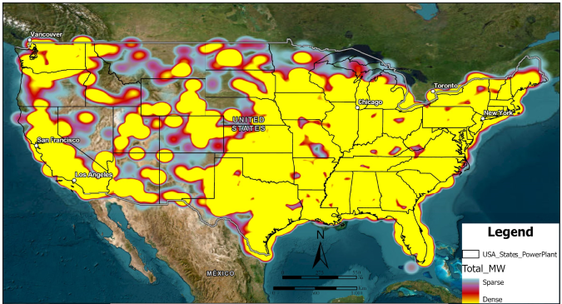
Dataset Visualization
Notes:
Data represents Power Plants across the U.S.
Pulled from ArcGIS Living Atlas Federal User Community
Regulated by federal departments and available for public consumption.

Slide 3
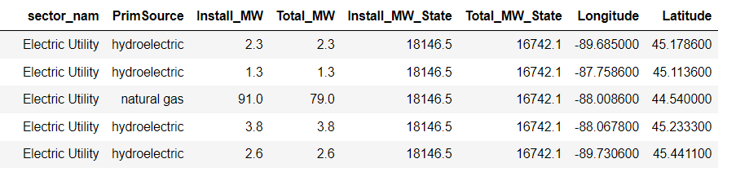
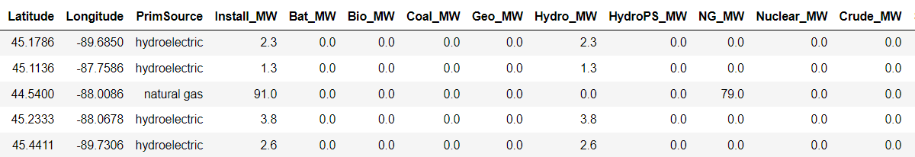
Data Set Description
Notes:
The data is broken down by Geographic location, fuel source, Total installed/max Cap, & individual fuel source capacity by site.
Contains 12,007 sites.

Slide 4
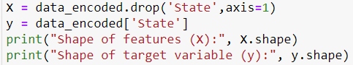
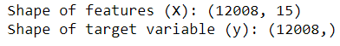
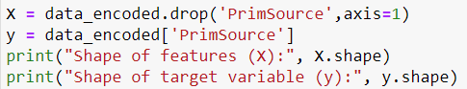
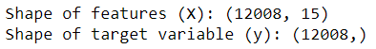
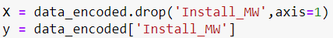
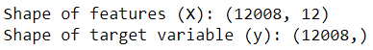
Preprocessing Techniques: Feature Selection & Standardization
Classification:
State
PrimSource
Regression:
Install_MW
Notes:
Preprocessing Techniques:
Categorical to numerical (Label Encoding)
Selection of relevant attributes
Using Install MW, Latitude, Longitude

Slide 5
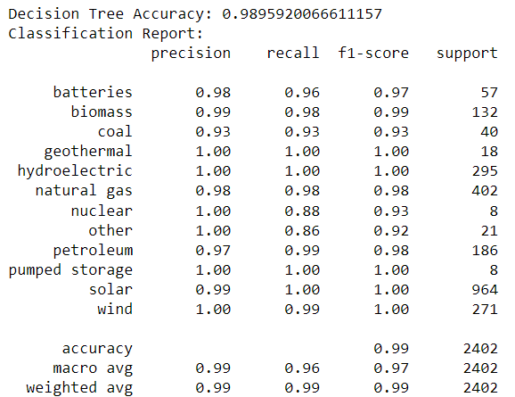
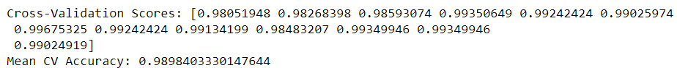
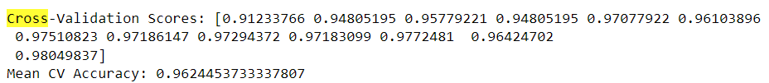
Machine Learning Technique: Decision Tree
Classification
Notes:
Machine Learning Technique: K-means Clustering:
Performed the elbow method to determine optimum values of k
Used values of 3, 5 & 7 to fit the data into visually correct values.

Slide 6
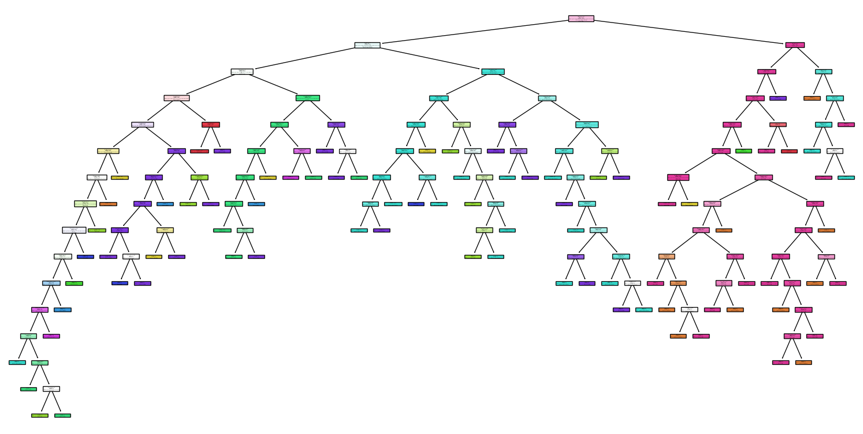
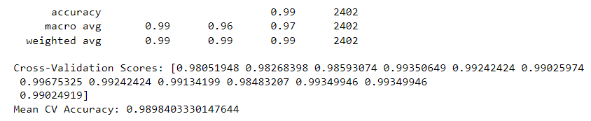
Machine Learning: Decision Tree Visualization
Decision Tree Results for the Primary Source

Slide 7
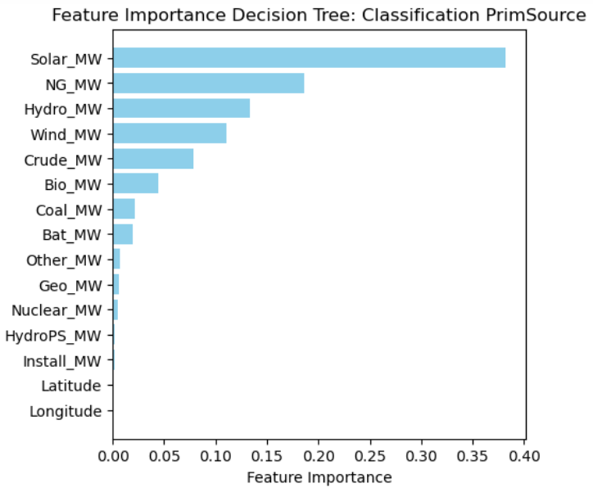
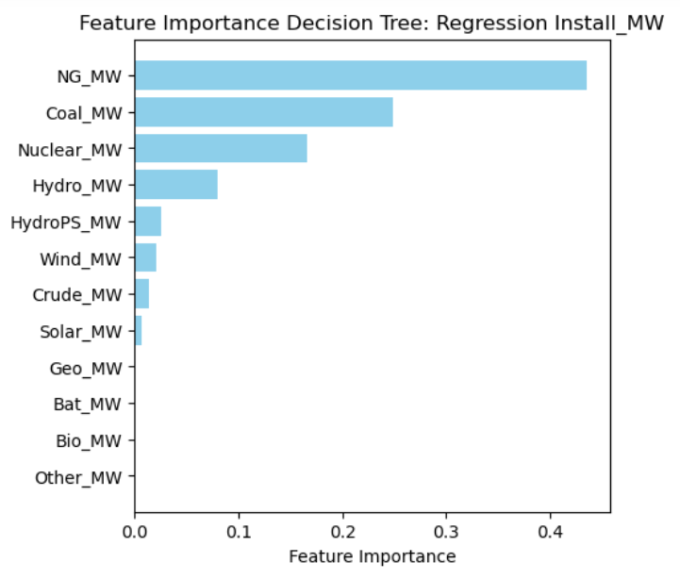
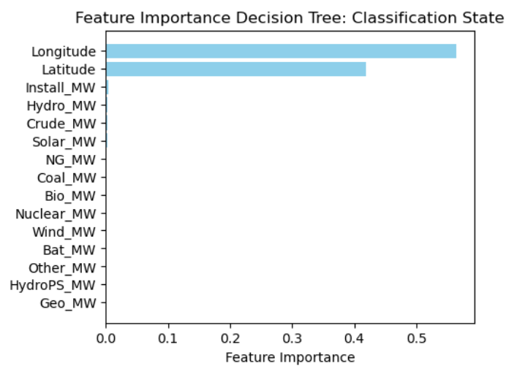
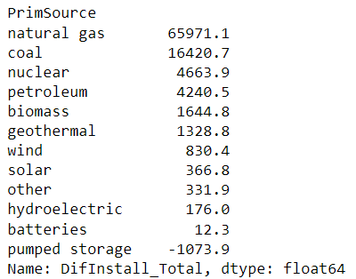
Machine Learning: Decision Tree
Primary Source, State and Regression Results

Slide 8
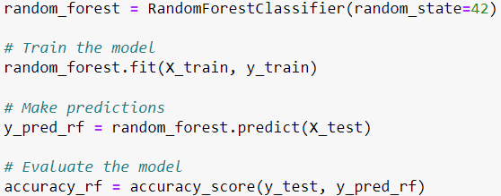
Machine Learning Technique: Random Forest
Classification PrimSource
Notes:
Machine Learning Technique: K-means Clustering:
Performed the elbow method to determine optimum values of k
Used values of 3, 5 & 7 to fit the data into visually correct values.

Slide 9
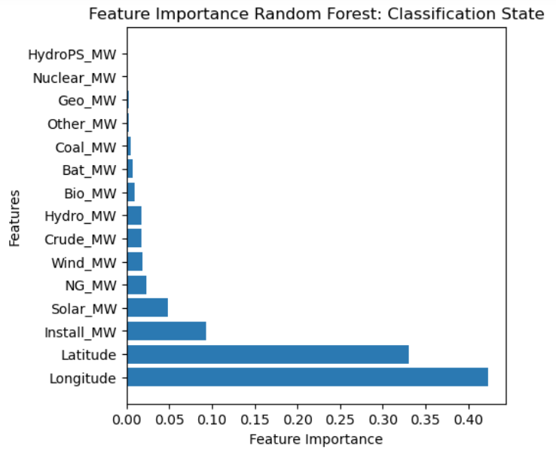
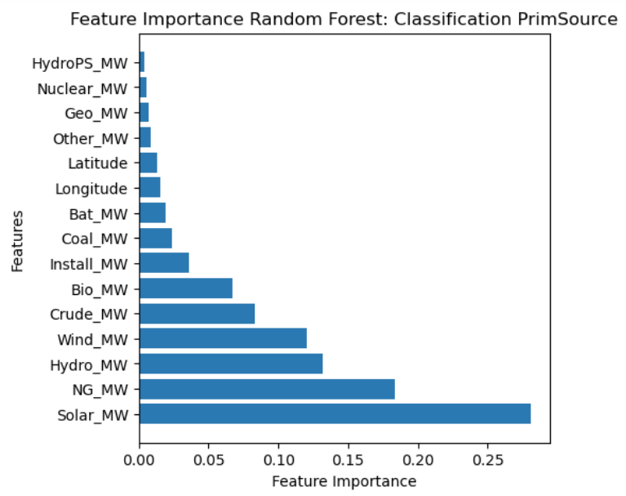
Random Forest: Feature importance

Slide 10
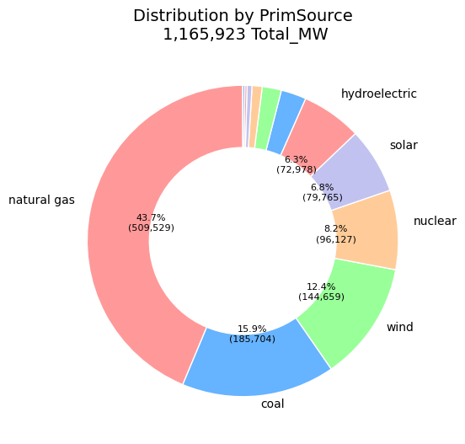
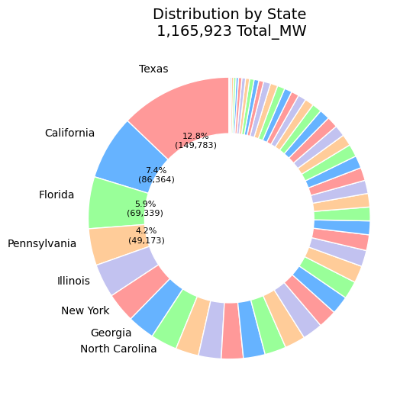
Distribution Results by Prime Source and State
Classification Results:
State
PrimSource
Notes:
Preprocessing Techniques:
Categorical to numerical (Label Encoding)
Selection of relevant attributes
Using Install MW, Latitude, Longitude

Slide 11
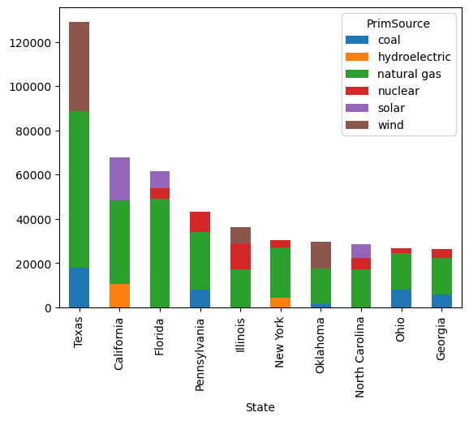
Distribution Results by Prime Source and State
Classification Results:
State
PrimSource
Top three primary source for the top 10 states
Notes:
Preprocessing Techniques:
Categorical to numerical (Label Encoding)
Selection of relevant attributes
Using Install MW, Latitude, Longitude

Slide 12
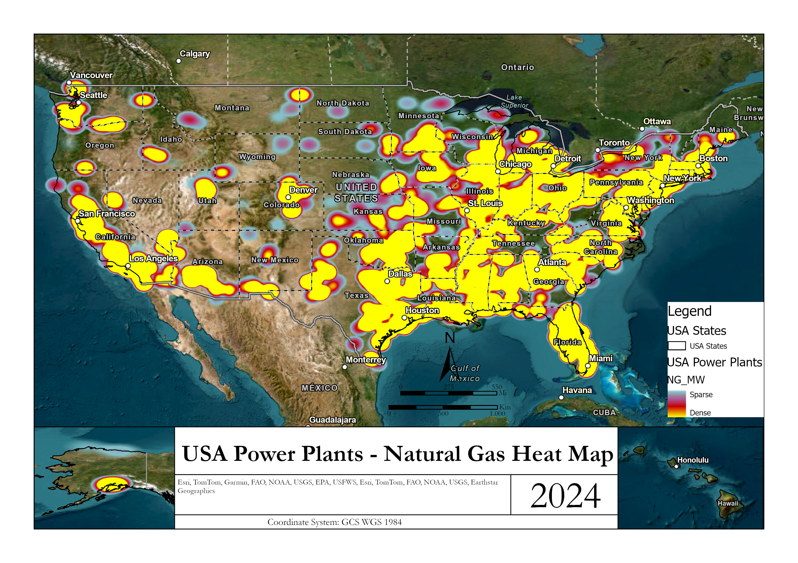
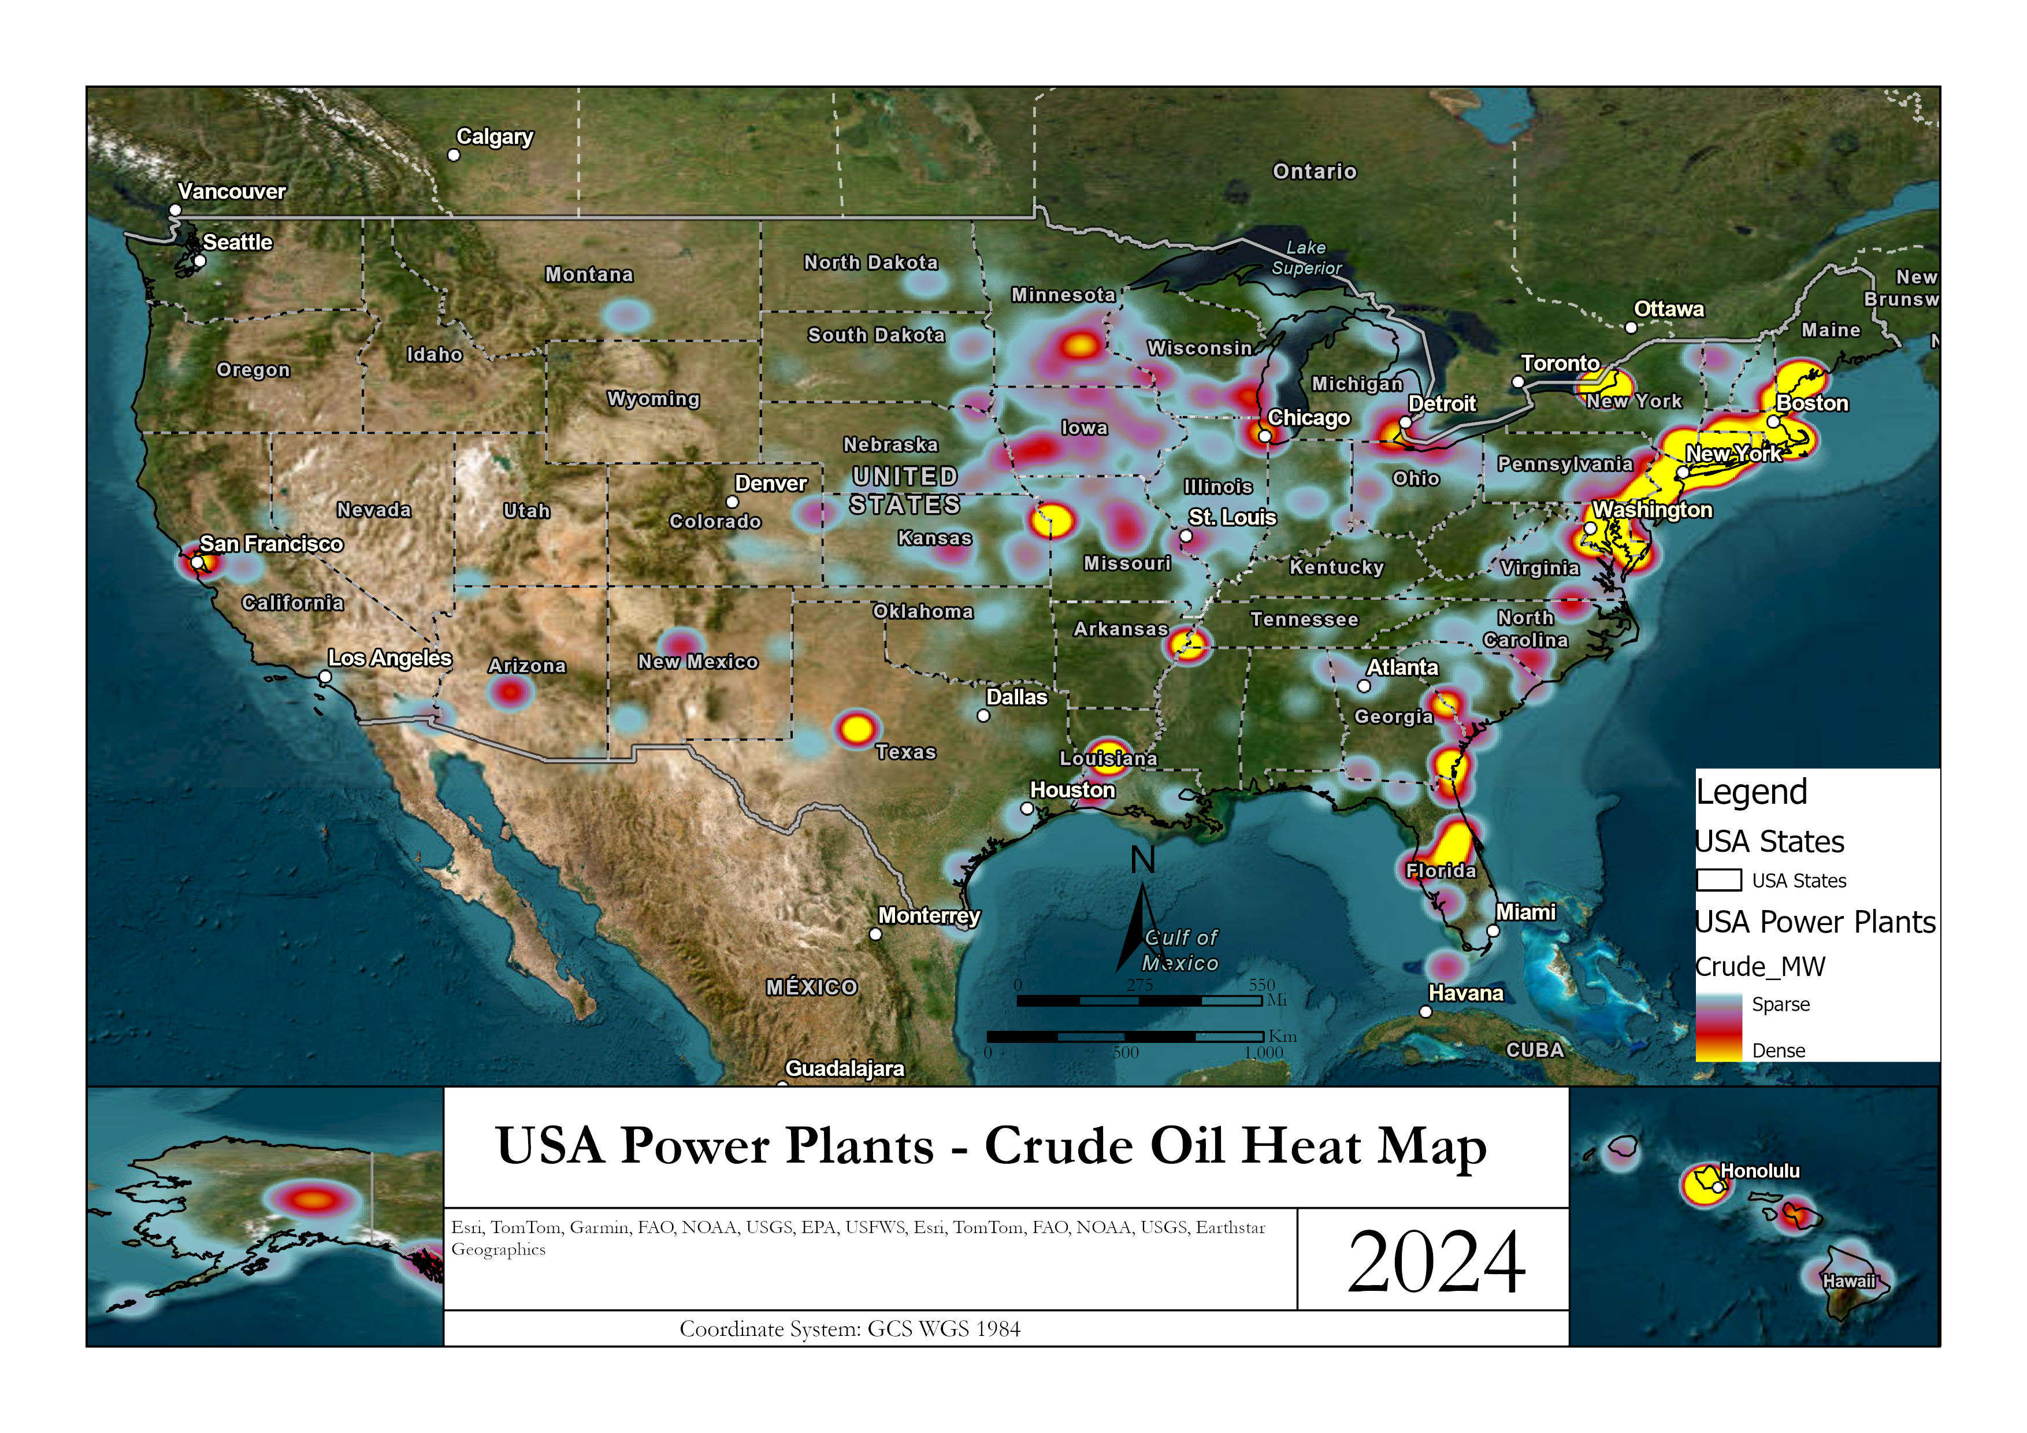
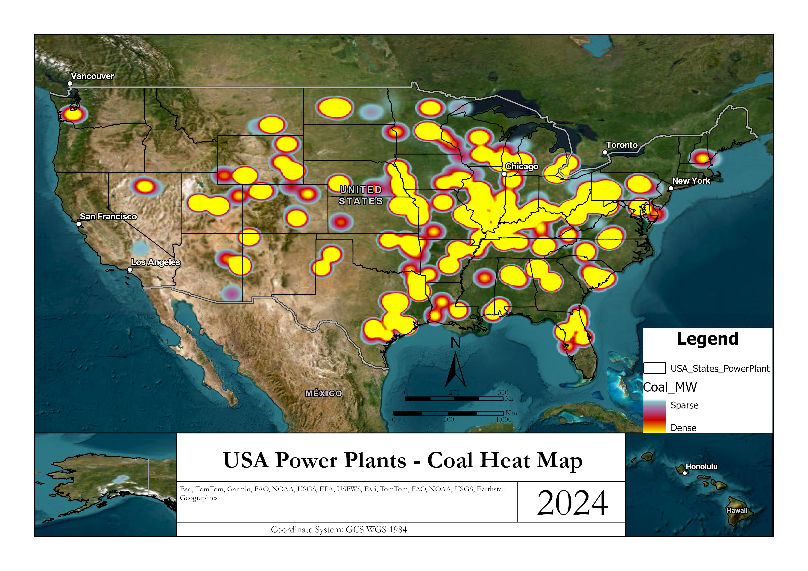
Non-Renewable Energy – Heat Maps

Slide 13
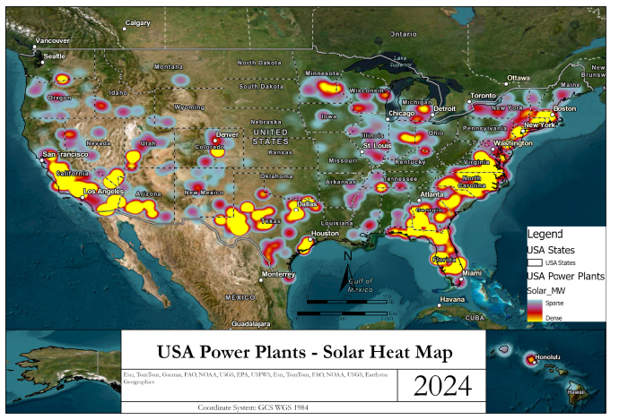
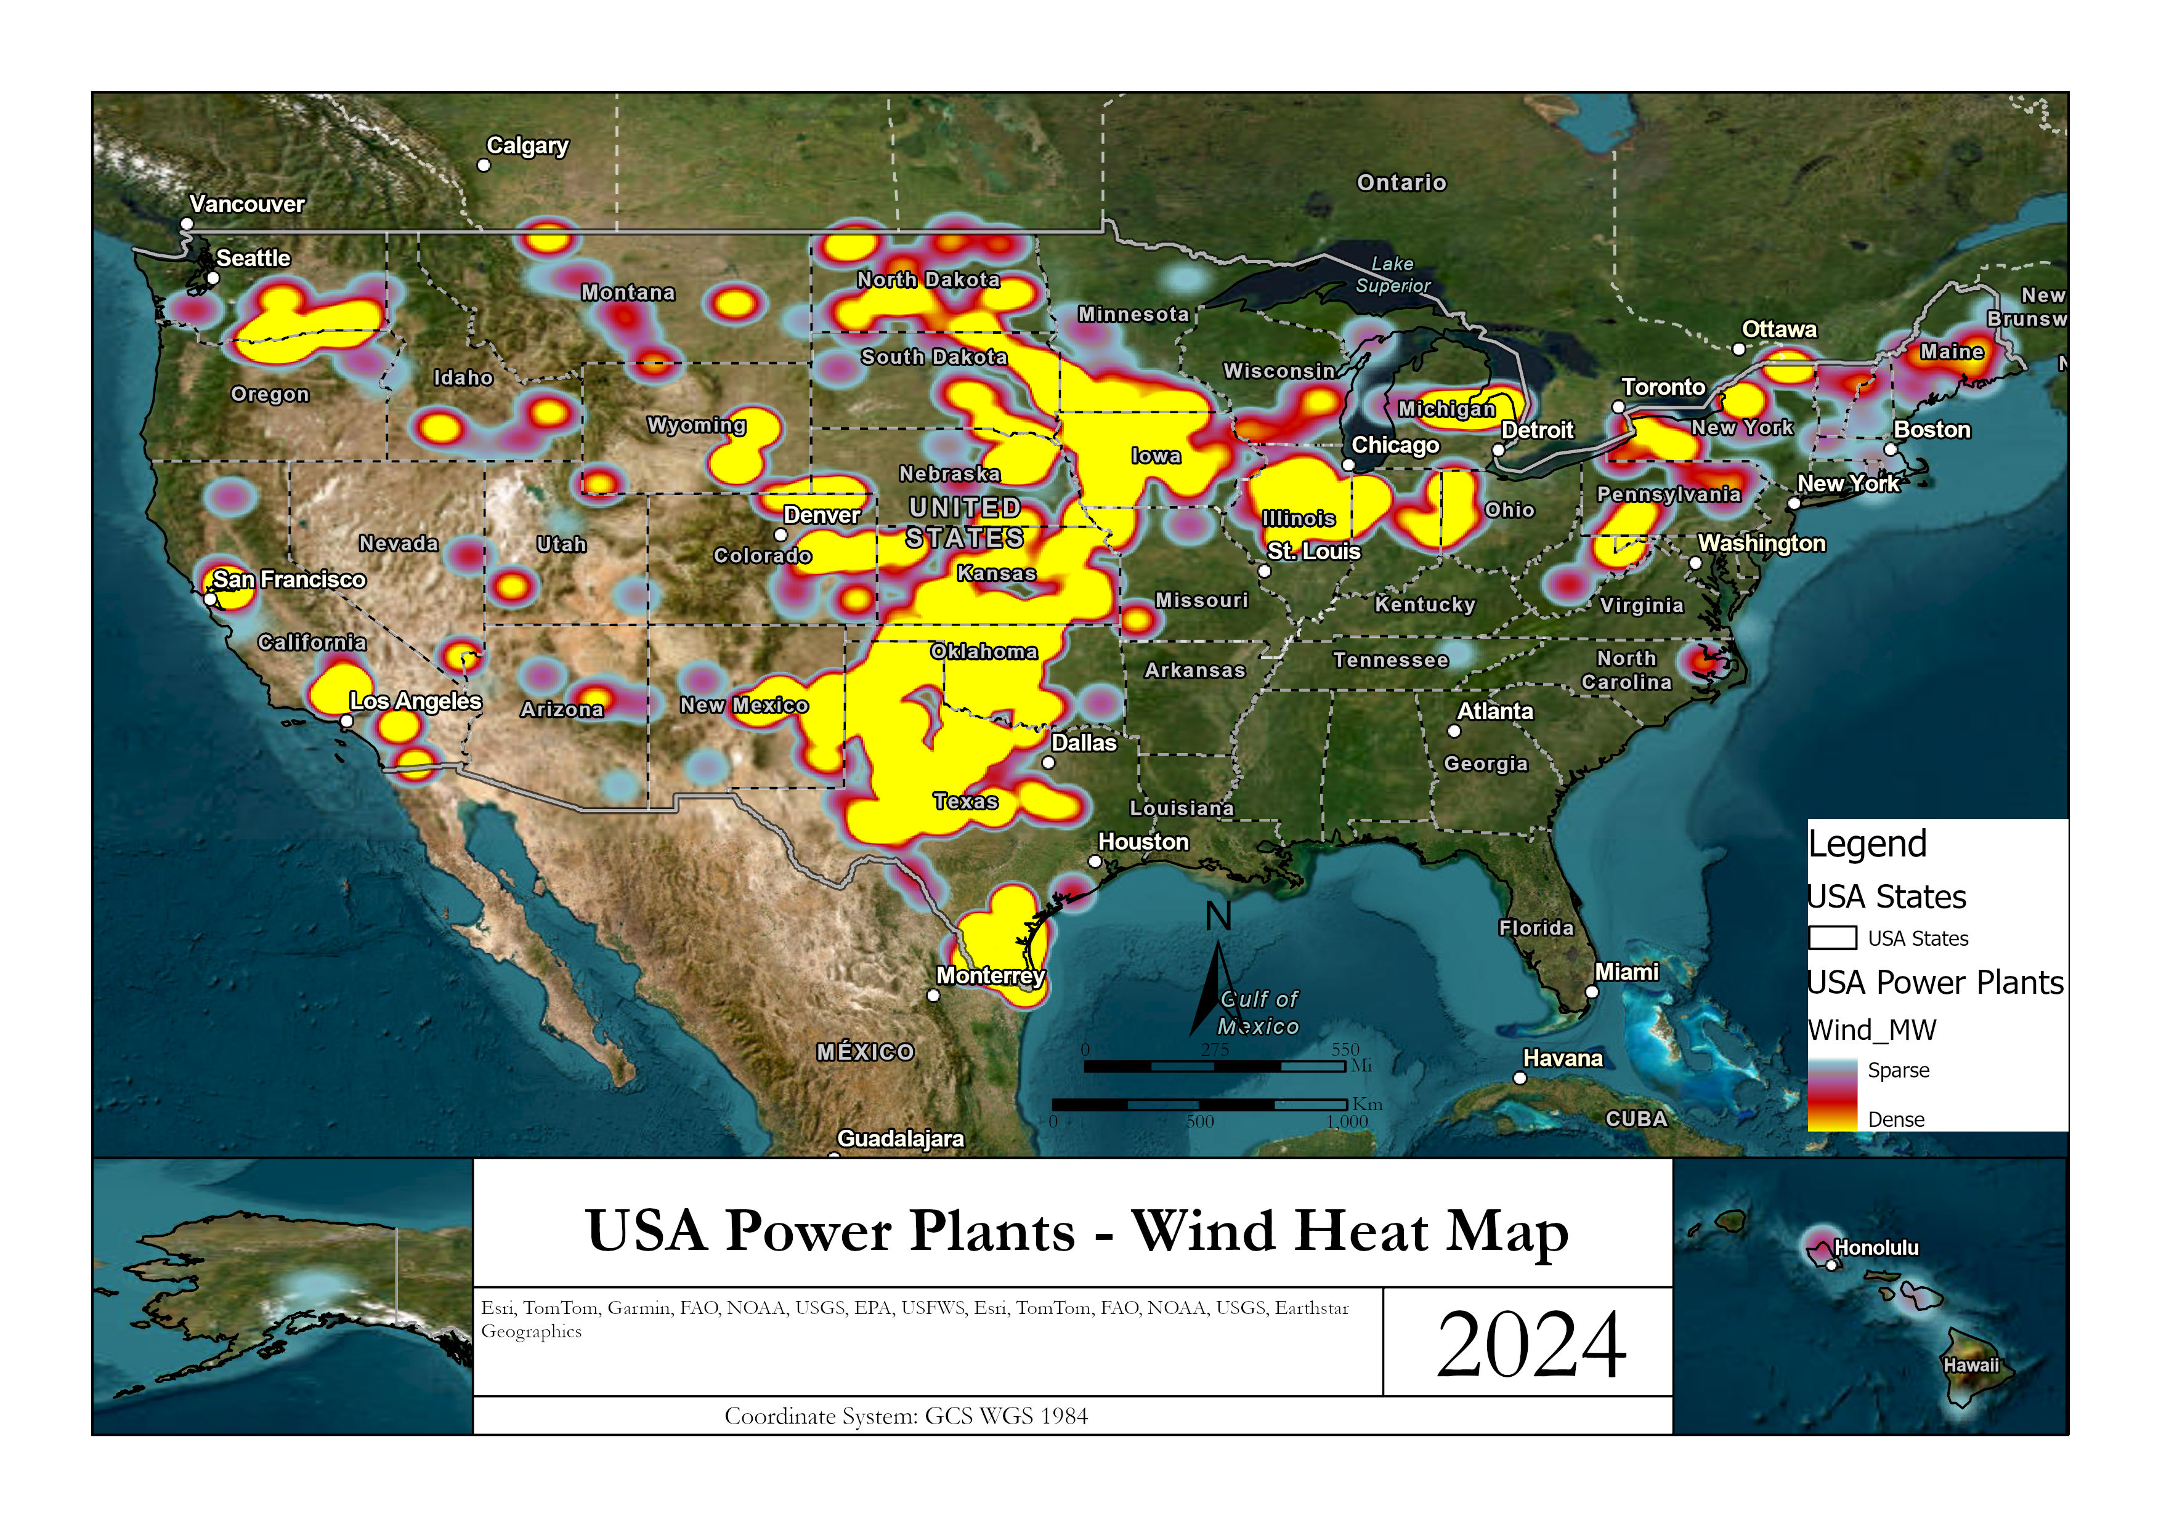
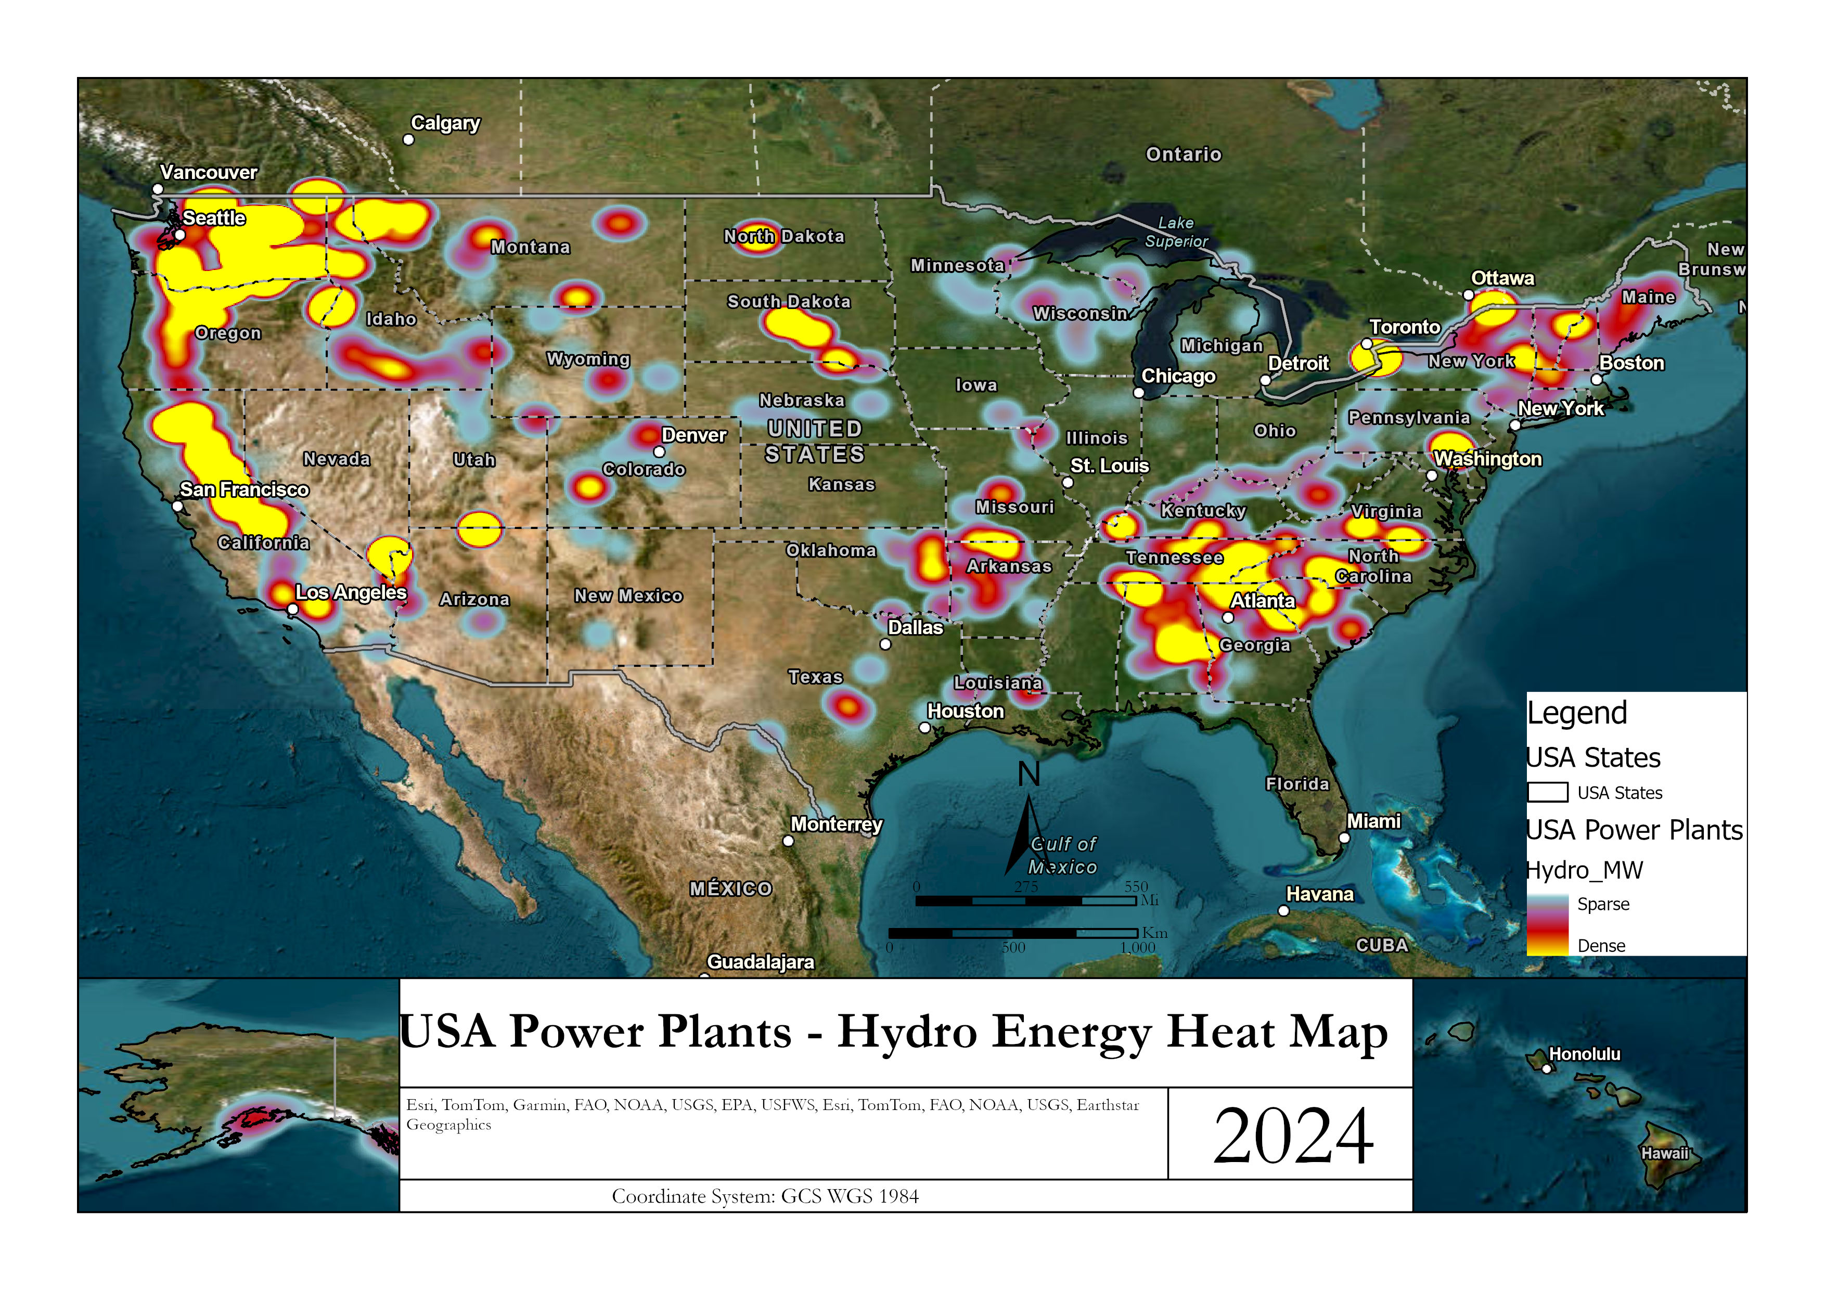
Renewable Energy – Heat Maps

Slide 14
Conclusion
Solar power plants represent an important feature in energy generation because is the greatest power plant in the US (42%)
The classification of the State in the random forest takes the coordinates as the greater feature importance. It is expected because the state is a place in the US. The coordinates are followed by the ‘Install_MW” which is due to the energy generation by State; every state has a different amount of energy generation (e.g. Texas is the greatest energy generatior in the US).
Wind energy importance is because the majority comes from states in the middle of the country (Iowa, Oklahoma, Illinois)
Notes:
Cluster Analysis & conclusions:
We learned that different types of preprocessing can be utilized to perform a variety of further analysis especially depending on the type and variety of data that is collected.
Using power plants gives a wide range of initial attributes.
Once K values are determined even if using the optimum value (i.e. 3) doesn’t translate to accurate clusters. So we played around with different values until we got a proper fit. The best fit from my perspective came with the value of k=7.

Slide 15
References
https://montclair.maps.arcgis.com/home/item.html?id=b063316fac7345dba4bae96eaa813b2f (US Power Plants Data source)
https://pro.arcgis.com/en/pro-app/latest/tool-reference/spatial-statistics/multivariate-clustering.htm (ArcGIS - Multivariate Clustering Tool)

